Slide 1
JavaScript: Introduction to Scripting

Slide 2
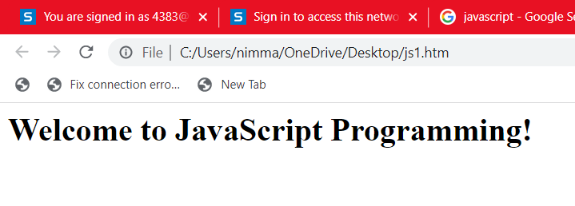
JavaScript (JS) is a lightweight, interpreted, or just-in-time compiled programming language with first-class functions. While it is most well-known as the scripting language for Web pages, many non-browser environments also use it, such as Node.js, Apache CouchDB and Adobe Acrobat.
JavaScript scripting language, which is used to enhance the functionality and appearance of web pages.
Your First Script: Displaying a Line of Text with JavaScript in a Web Page
All major web browsers contain JavaScript interpreters, which process the commands written in JavaScript.
<html>
<head>
<title>A First Program in JavaScript</title>
<script type = "text/javascript">
document.writeln(
"<h1>Welcome to JavaScript Programming!</h1>" );
</script>
</head><body></body>
</html>

Slide 3
The script Element and Commenting Your Scripts
<script> tag to indicate to the browser that the text which follows is part
of a script.
The type attribute specifies the MIME type of the script as well as the scripting
language used in the script—in this case, a text file written in java script.
In HTML5,the default MIME type for a <script> is "text/html", so you can omit the type attribute from your <script> tags
Using the document Object
The browser’s document object, which represents the HTML5 document the browser is currently displaying.
This object allows you to specify text to display in the HTML5 document. The browser creates a set of objects that allow you to access and manipulate every element of an HTML5 document.
writeln method to write a line of HTML5 markup in the HTML5 document.
The parentheses following the method name writeln contain the one argument that method writeln requires (in this case, the string of HTML5 that the browser is to display)

Slide 4
Modifying Your First Script
Displaying a Line of Colored Text
A script can display Welcome to JavaScript Programming! in many ways. The below code displays the text in magenta, using the CSS color property
<html>
<head>
<title>A First Program in JavaScript</title>
<script type = "text/javascript">
document.write( "<h1 style = 'color: magenta'>" );
document.write( "Welcome to JavaScript " + "Programming!</h1>" );
</script>
</head><body></body>
</html>
Nesting Quotation Marks
a string can be delimited by single (') or double (") quote characters. Within a string, you can’t nest quotes of the same type, but you can nest quotes of the other type.

Slide 5
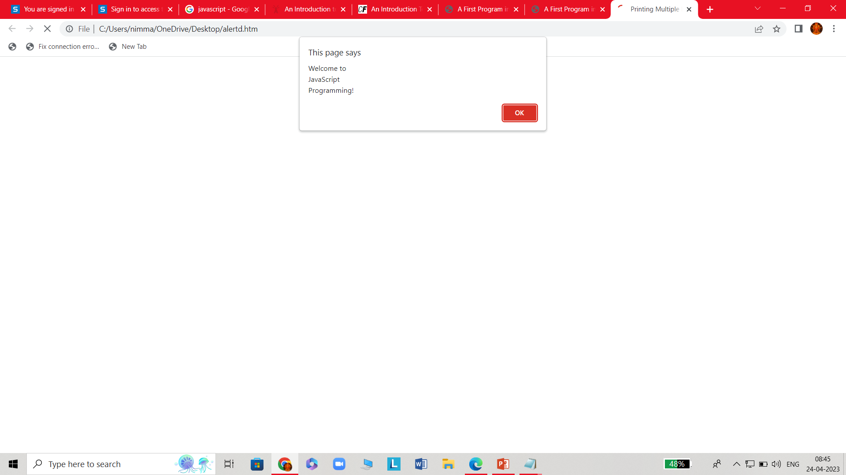
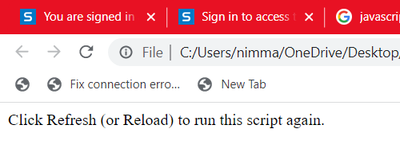
Displaying Text in an Alert Dialog
It’s useful to display information in windows called dialogs (or dialog boxes) that “pop up” on the screen to grab the user’s attention.
Dialogs typically display important messages to users browsing the web page. JavaScript allows you easily to display a dialog box containing a message.
<html>
<head>
<title>Printing Multiple Lines in a Dialog Box</title>
<script type = "text/javascript">
window.alert( "Welcome to\nJavaScript\nProgramming!" );
</script> </head>
<body>
<p>Click Refresh (or Reload) to run this script again.</p>
</body>
</html>

Slide 6
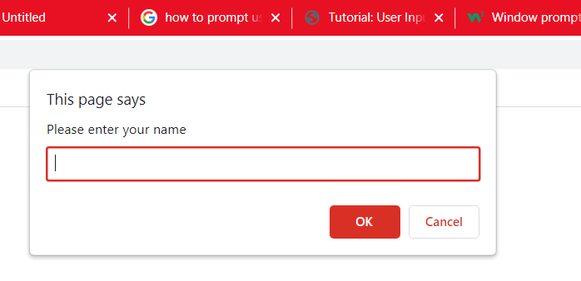
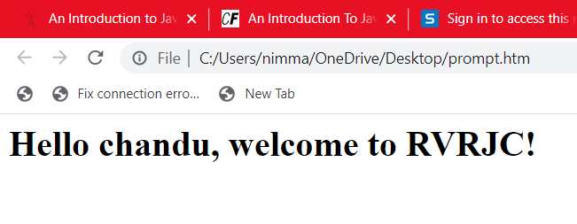
Obtaining User Input with prompt Dialogs
A large part of user interaction is allowing users to input information into a program.
In JavaScript, we use the prompt() function to ask the user for input. As a parameter, we input the text we want to display to the user.
Once the user presses “ok,” the input value is returned. We typically store user input in a variable so that we can use the information in our program.
<html>
<head>
<title>Using Prompt and Alert Boxes</title>
<script type = "text/javascript">
// string entered by the user
// read the name from the prompt box as a string
name = window.prompt( "Please enter your name" );
document.writeln( "<h1>Hello " + name + ", welcome to RVRJC!</h1>" );
</script>
</head><body></body>
</html

Slide 7
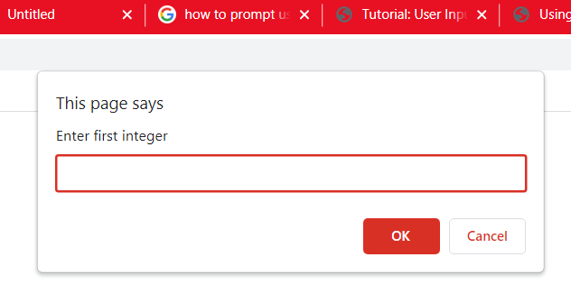
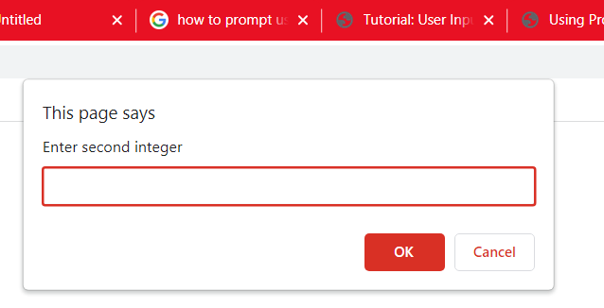
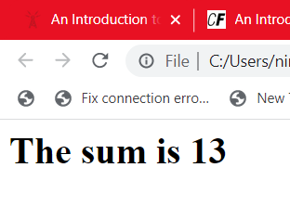
<html>
<head>
<title>An Addition Program</title>
<script type = "text/javascript">
var firstNumber; // first string entered by user
var secondNumber; // second string entered by user
var number1; // first number to add
var number2; // second number to add
var sum; // sum of number1 and number2
firstNumber = window.prompt( "Enter first integer" );
secondNumber = window.prompt( "Enter second integer" );
// convert numbers from strings to integers
number1 = parseInt( firstNumber );
number2 = parseInt( secondNumber );
sum = number1 + number2; // add the numbers
// display the results
document.writeln( "<h1>The sum is " + sum + "</h1>" );
</script>
</head><body></body>
</html>

Slide 8
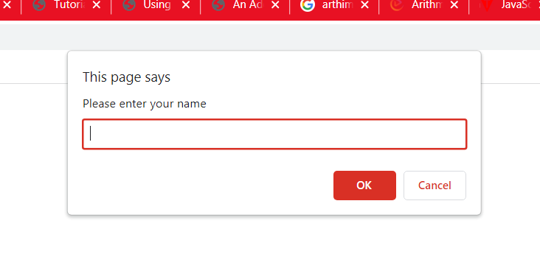
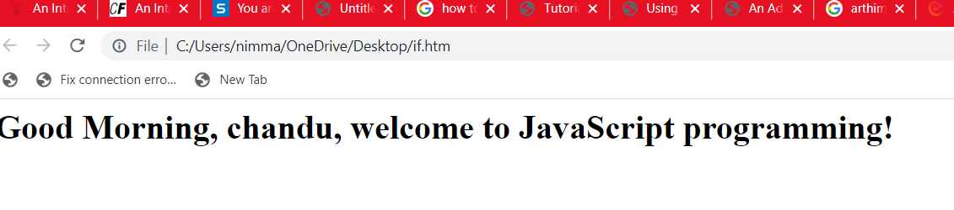
Decision Making
<html>
<head>
<title>Using Relational Operators</title>
<script type = "text/javascript">
var name; // string entered by the user
var now = new Date();
var hour = now.getHours();
name = window.prompt( "Please enter your name" );
if ( hour < 12 )// determine whether it’s morning
document.write( "<h1>Good Morning, " );
if ( hour >= 12 )// determine whether the time is PM
{
hour = hour - 12;// convert to a 12-hour clock
if ( hour < 6 )// determine whether it is before 6 PM
document.write( "<h1>Good Afternoon, " );
if ( hour >= 6 )// determine whether it is after 6 PM
document.write( "<h1>Good Evening, " );
} // end if
document.writeln( name + ", welcome to JavaScript programming!</h1>" );
</script>
</head><body></body> </html>

Slide 9
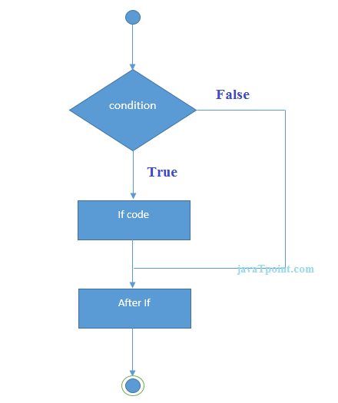
The JavaScript if-else statement is used to execute the code whether condition is true or false. There are three forms of if statement in JavaScript.
If Statement
If else statement
if else if statement
If statement
It evaluates the content only if expression is true. The signature of JavaScript if statement is given below.
if(expression){ //content to be evaluated }
Flowchart of JavaScript If statement
<html>
<body>
<script>
var a=20;
if(a>10){
document.write("value of a is greater than 10");
}
</script> </body></html>

Slide 10
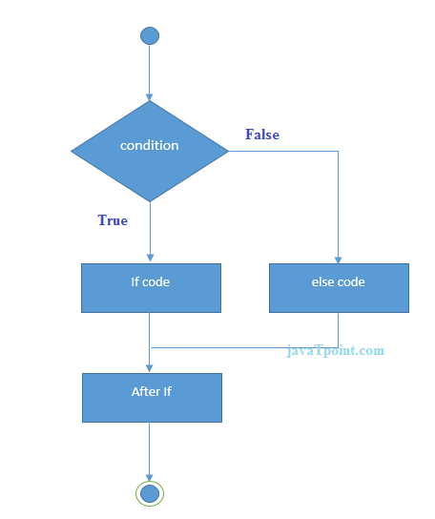
If...else Statement
It evaluates the content whether condition is true of false. The syntax of JavaScript if-else statement is given below.
if(expression){ //content to be evaluated if condition is true }
else{ //content to be evaluated if condition is false }
Flowchart of JavaScript If...else statement
To find out the even or odd number
<html>
<body>
<script>
var a=20;
if(a%2==0){
document.write("a is even number");
}
else{
document.write("a is odd number");
}
</script></body></html>

Slide 11
If...else if statement
It evaluates the content only if expression is true from several expressions. The signature of JavaScript if else if statement is given below.
if(expression1){ //content to be evaluated if expression1 is true }
else if(expression2){ //content to be evaluated if expression2 is true }
else if(expression3){ //content to be evaluated if expression3 is true }
else{ //content to be evaluated if no expression is true }
<html>
<body>
<script>
var a=20;
if(a==10){ document.write("a is equal to 10"); }
else if(a==15){ document.write("a is equal to 15"); }
else if(a==20){ document.write("a is equal to 20"); }
else{ document.write("a is not equal to 10, 15 or 20"); }
</script> </body></html>

Slide 12
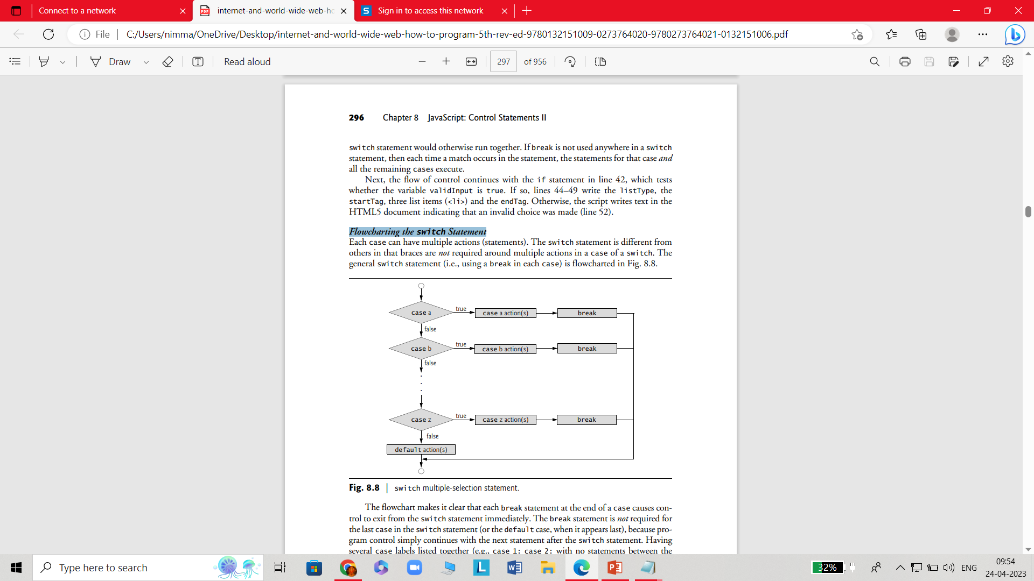
switch Multiple-Selection Statement
switch statement is used to execute one code from multiple expressions. It is just like else if statement .
The signature of JavaScript switch statement is given below.
switch(expression){
case value1:
code to be executed;
break;
case value2:
code to be executed;
break;
......
default:
code to be executed if above values are not matched;
}
Flowcharting the switch Statement

Slide 13
<!DOCTYPE html>
<html>
<body>
<script>
var grade='B';
var result;
switch(grade){
case 'A':
result="A Grade";
break;
case 'B':
result="B Grade";
break;
case 'C':
result="C Grade";
break;
default:
result="No Grade";
}
document.write(result);
</script> </body> </html>

Slide 14
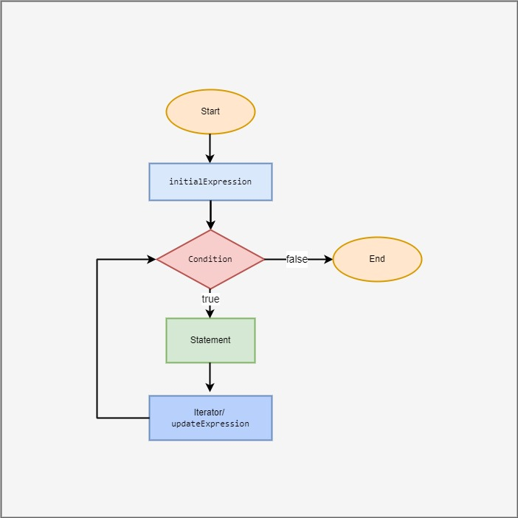
What are Loops?
Loops are computer programs that execute a set of instructions or a block of code a certain number of times without having to write it again until a certain condition is met. In other words, loops let your code execute one or more statements as many times as desired.
For
The for loop is an iterative statement which you use to check for certain conditions and then repeatedly execute a block of code as long as those conditions are met.
Syntax of a for loop
for (initial Expression; condition; update Expression) {
// for loop body: statement
}

Slide 15
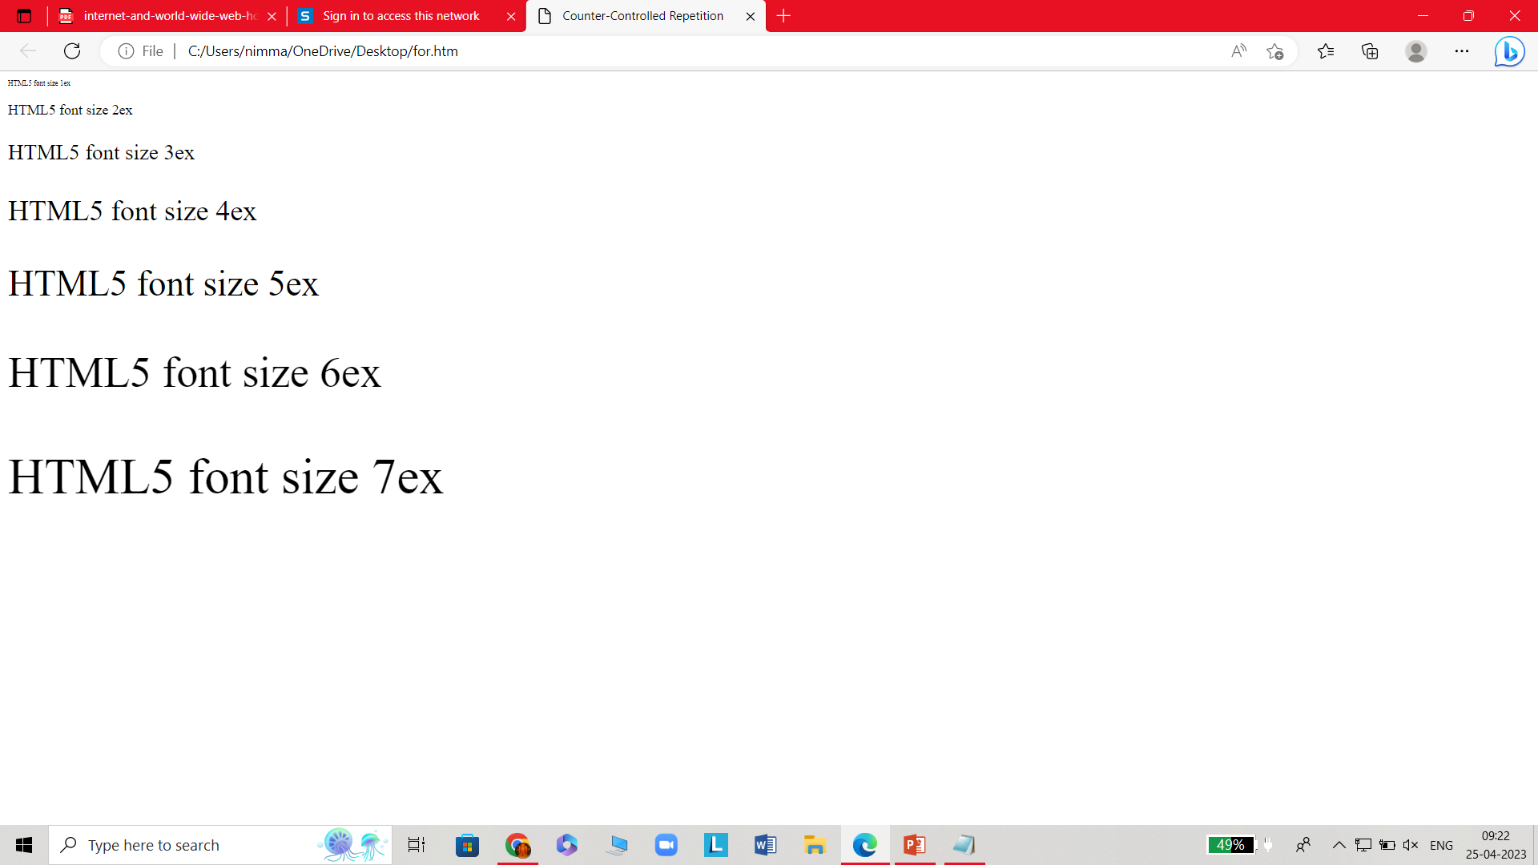
Ex:
<html>
<head>
<title>Counter-Controlled Repetition</title>
<script>
// Initialization, repetition condition and
// incrementing are all included in the for
// statement header.
for ( var counter = 1; counter <= 7; ++counter )
document.writeln( "<p style = 'font-size: " + counter + "ex'>HTML5 font size " + counter + "ex</p>" );
</script>
</head><body></body>
</html>

Slide 16
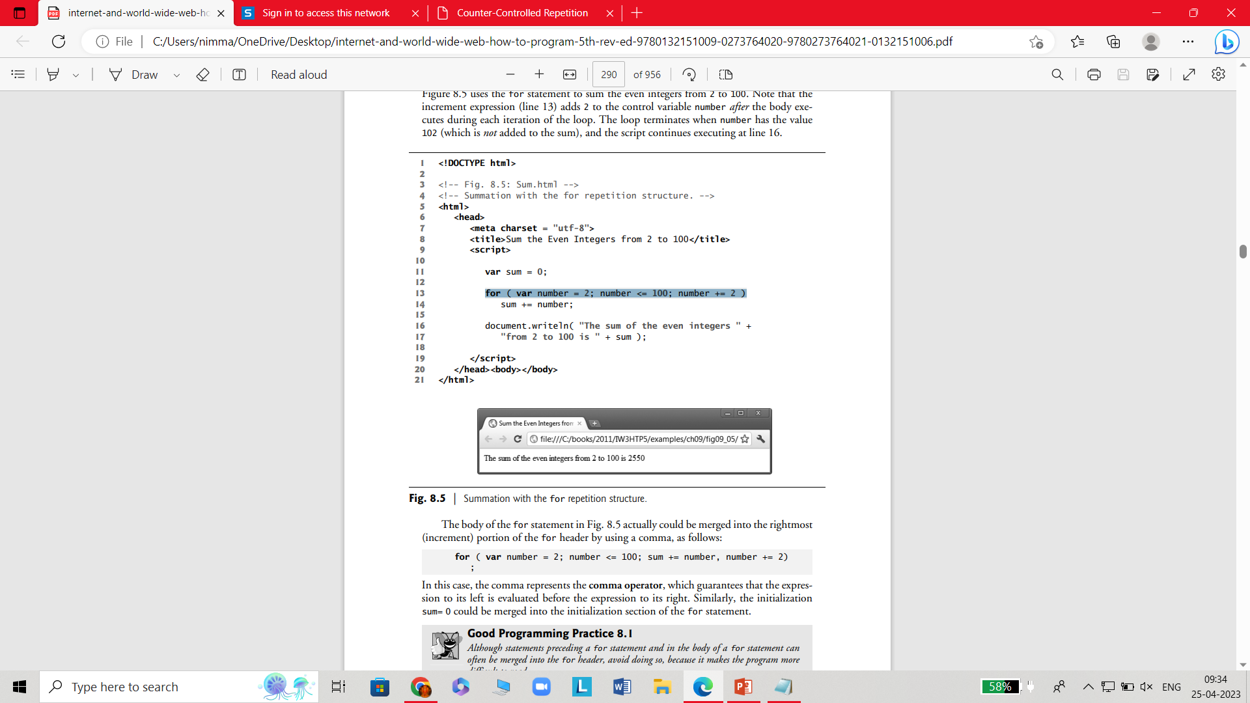
Ex:
<html>
<head>
<title>Sum the Even Integers from 2 to 100</title>
<script>
var sum = 0;
for ( var number = 2; number <= 100; number += 2 )
sum += number;
document.writeln( "The sum of the even integers " +"from 2 to 100 is " + sum );
</script>
</head><body></body>
</html>

Slide 17
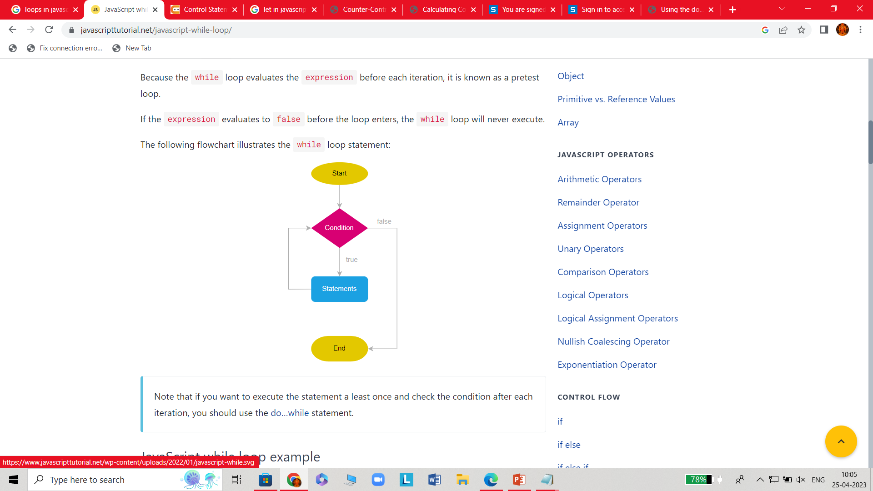
While Statement
The JavaScript while statement creates a loop that executes a block as long as a condition evaluates to true.
The while statement evaluates the expression before each iteration of the loop.
If the expression evaluates to true, the while statement executes the statement. Otherwise, the while loop exits.
Because the while loop evaluates the expression before each iteration, it is known as a pretest loop.
If the expression evaluates to false before the loop enters, the while loop will never execute.
Syntax:
while (the_condition_is_put_here)
{ //the code block is executed when the conditions are met }

Slide 18
Ex:
<html>
<head>
<title>Counter-Controlled Repetition</title>
<script>
var counter = 1; // initialization
while ( counter <= 7 ) // repetition condition
{
document.writeln( "<p style = 'font-size: " +
counter + "ex'>HTML5 font size " + counter + "ex</p>" );
++counter; // increment
} //end while
</script>
</head><body></body>
</html>

Slide 19
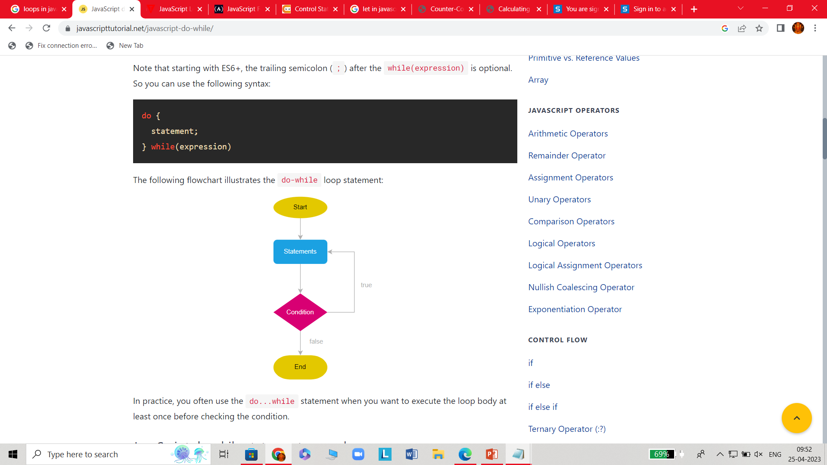
do…while statement
The do...while loop statement creates a loop that executes a block until a condition evaluates to false.
Unlike the while loop, the do-while loop always executes the statement at least once before evaluating the expression.
Because the do...while loop evaluates expression after each iteration, it’s often referred to as a post-test loop.
Inside the loop body, you need to make changes to some variables to ensure that the expression is false after some iterations. Otherwise, you’ll have an indefinite loop.
The following statement illustrates the syntax of the do...while loop:
do {
statement;
} while(expression);

Slide 20
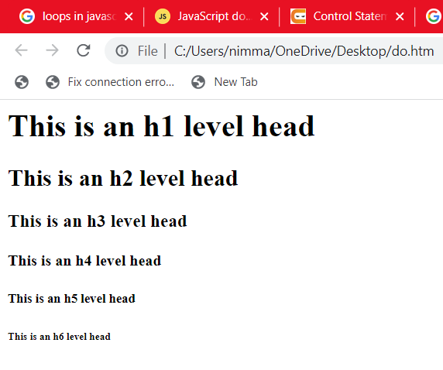
<html>
<head>
<title>Using the do...while Repetition Statement</title>
<script>
var counter = 1;
do {
document.writeln( "<h" + counter + ">This is " + "an h" + counter + " level head" + "</h" +
counter + ">" );
++counter;
} while ( counter <= 6 );
</script>
</head><body></body>
</html>

Slide 21
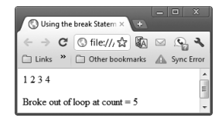
break and continue statements in JavaScript
The break statement in JavaScript
The break statement, or keyword, in JavaScript is used to jump out of the current loop.
syntax : break;
Ex:
<html>
<head>
<title>Using the break Statement </title>
<script>
for ( var count = 1; count <= 10; ++count )
{
if ( count == 5 )
break; // break loop only if count == 5
document.writeln( count + " " );
} //end for
document.writeln( "<p>Broke out of loop at count = " + count + "</p>" );
</script>
</head><body></body>
</html>

Slide 22
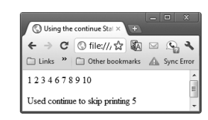
The continue statement in JavaScript
The JavaScript continue statement or keyword is used to skip the execution of statement(s) for the current iteration of the current loop.
Syntax:
continue;
Ex:
<html>
<head>
<title>Using the continue Statement </title>
<script>
for ( var count = 1; count <= 10; ++count )
{
if ( count == 5 )
continue; // skip remaining loop code only if count == 5
document.writeln( count + " " );
} //end for
document.writeln( "<p>Used continue to skip printing 5</p>" );
</script>
</head><body></body>
</html>

